Slide 1

Medical Imaging Course Final Assignment
Visualization of DICOM images
By: Kaddour Seyf Eddine MESKI

Slide 2
Introduction

Slide 3
Objectives
Download the dataset HCC-TACE-Seg, specifically the data for the assigned patient HCC XYZ.
Utilize a third-party DICOM visualizer, with 3D-Slicer being recommended, to visualize the downloaded dataset.
Load the segmentation image and the corresponding CT image using the PyDicom library
Extract and organize the 'pixel array' data from both images based on relevant headers
Generate an animation, a GIF file, featuring a rotating Maximum Intensity Projection (MIP) on the coronal-sagittal planes.

Slide 4
Data description
HCC-TACE-Seg refers to a dataset specifically designed for hepatocellular carcinoma (HCC) studies related to Transarterial Chemoembolization (TACE) procedures.
In the context of HCC-TACE-Seg, the dataset likely contains imaging data, such as CT scans or MRIs, along with corresponding segmentations outlining the HCC tumors or other relevant structures of interest.

Slide 5
Implementation
Download the HCC 009 dataset.
Visualize the data with the help of 3Dslicer
Determine 4 segmentation: Liver, Mass, Portal vein and Abdominal aorta.
Load the DCM files whith the segmentation.
Apply the alpha-fusion for the first axis to creat the segmented images.
Using 69 projections images to creat our GIF image.

Slide 6
Implementation
Setting Path and Loading Segmentation Data
Loading Data Files
Normalizing the Data: The loaded pixel data is normalized by dividing it by the maximum value and rounding it.
Flipping Segmentation Array: The segmentation array is flipped along the second axis using np.flip().
Generating Segmented Images
Visualization - Median Planes View
Visualization - Sagittal Planes View
Visualization - Coronal Planes View
Generating Sagittal Plane Projections

Slide 7
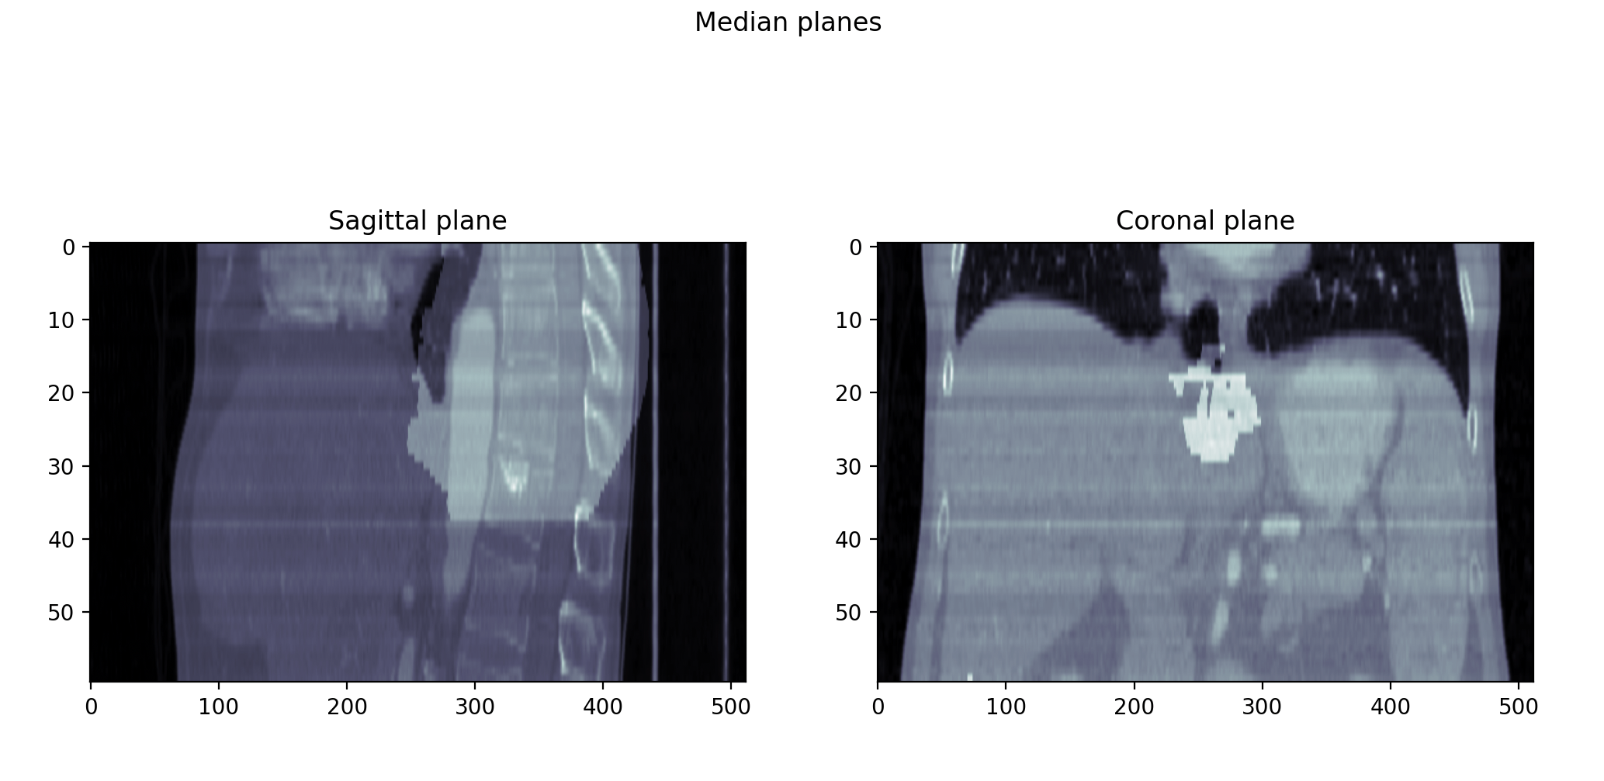
results

Slide 8
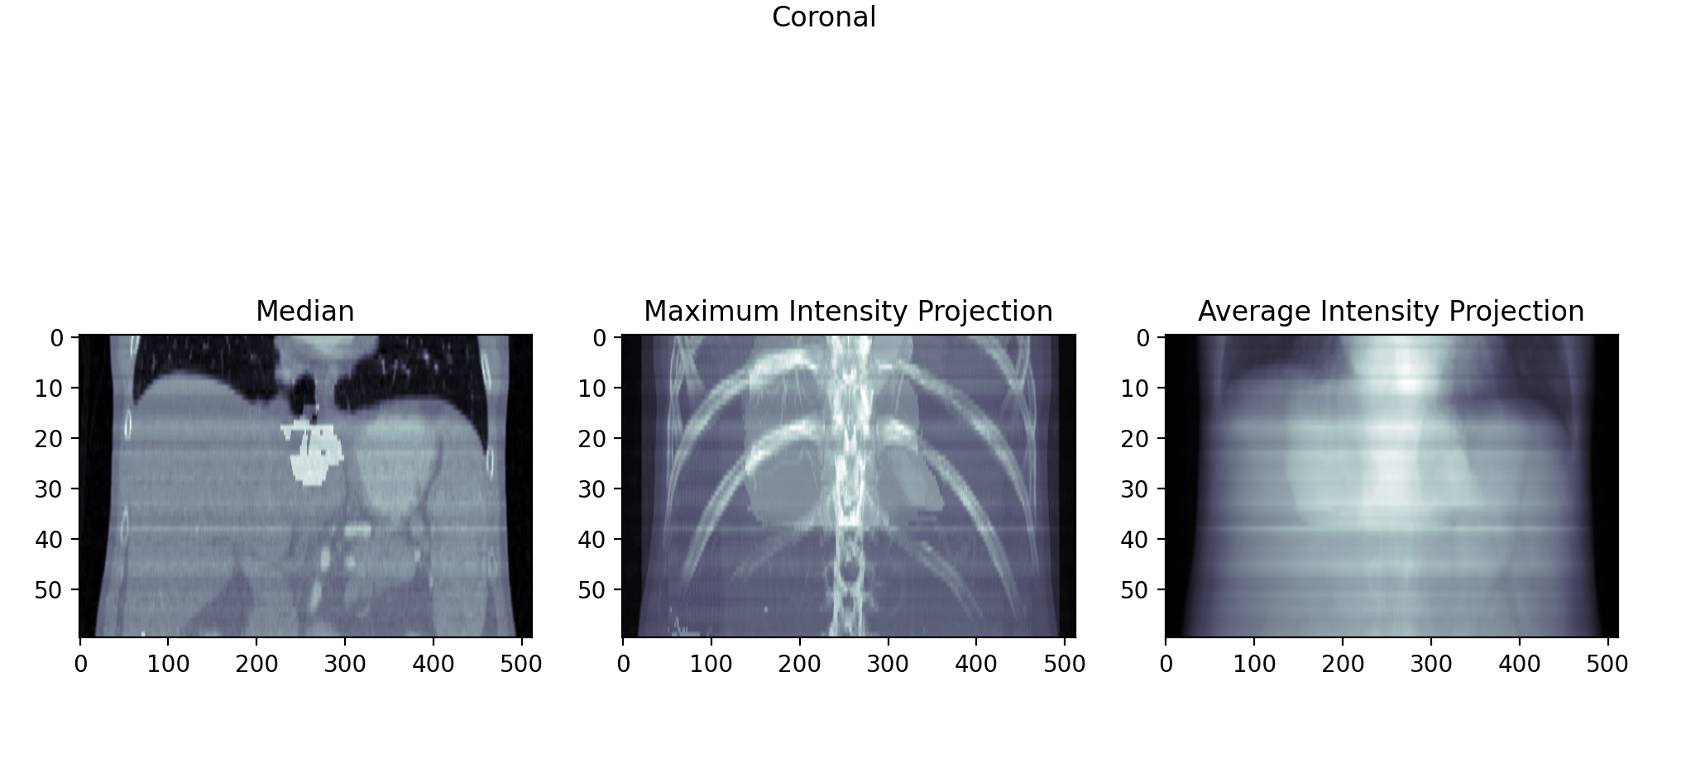
results

Slide 9
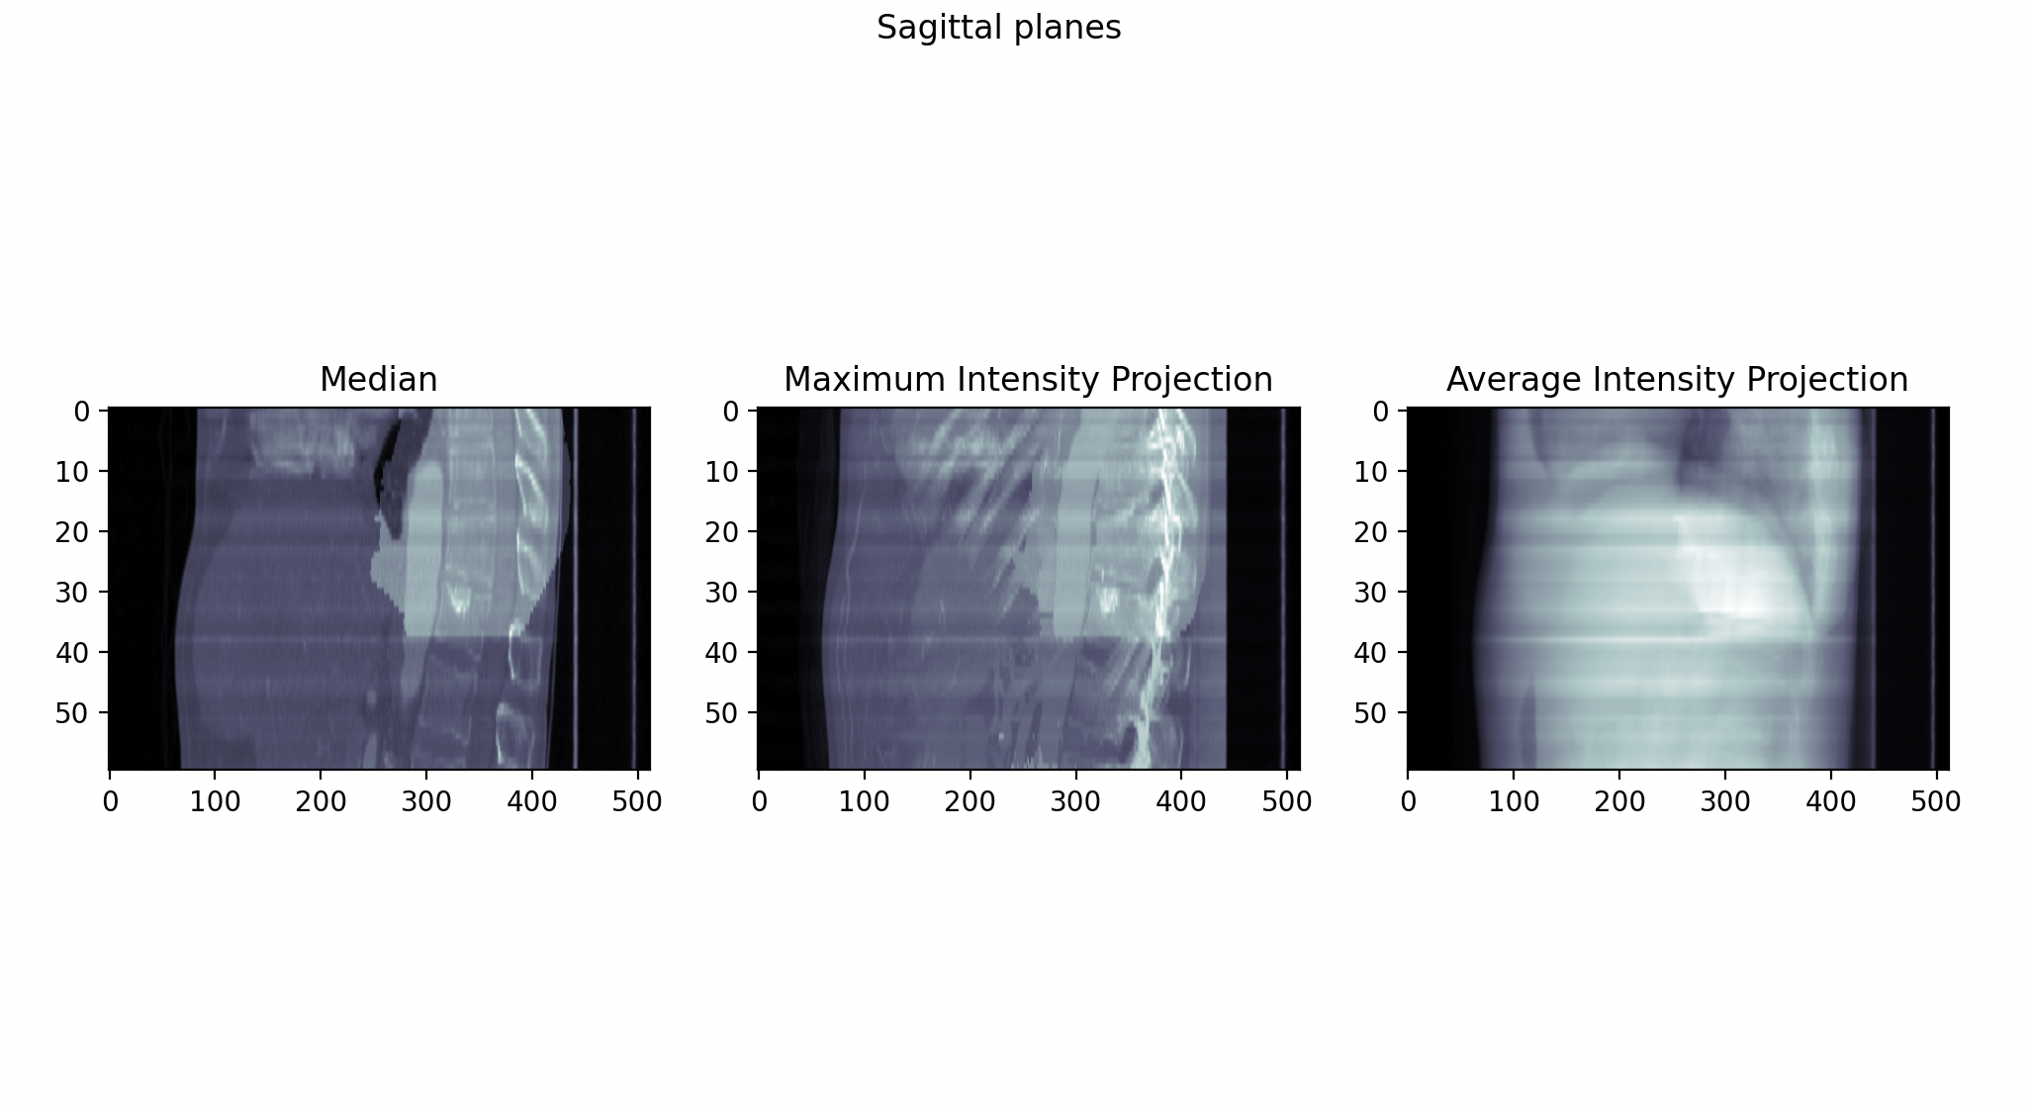
results

Slide 10
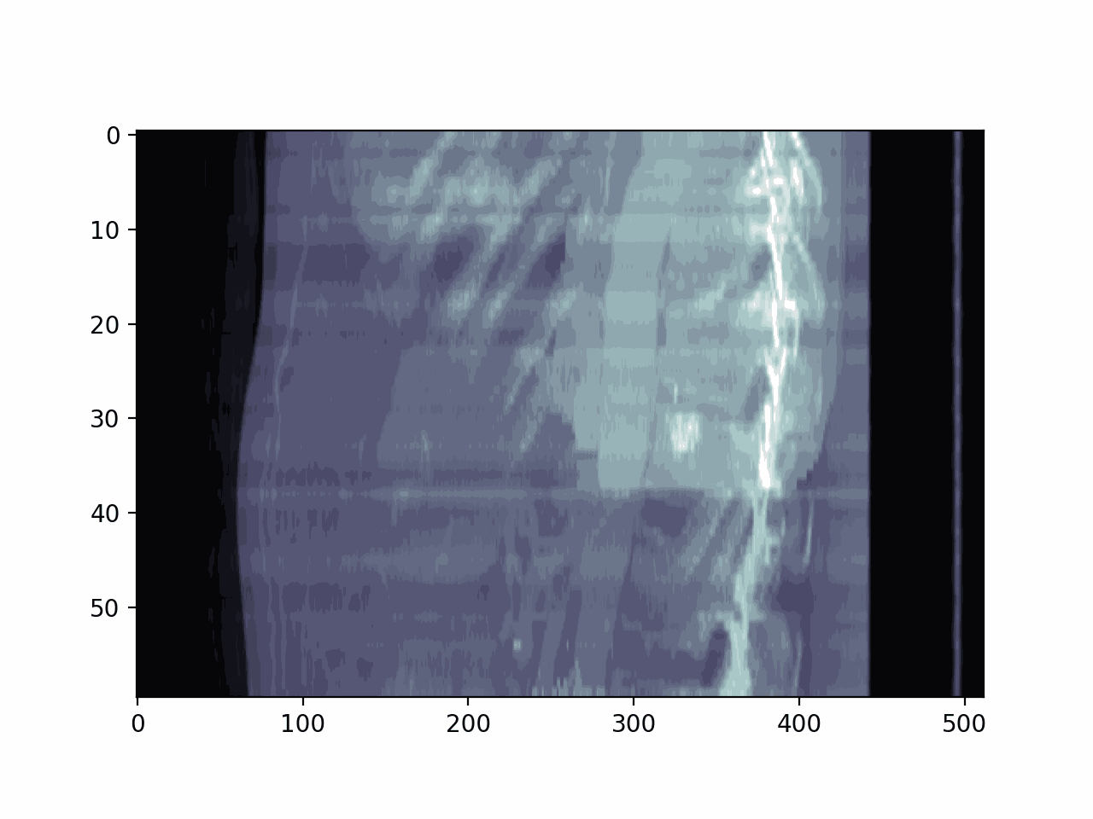
results

Slide 11
Thamk you

